Slide 1
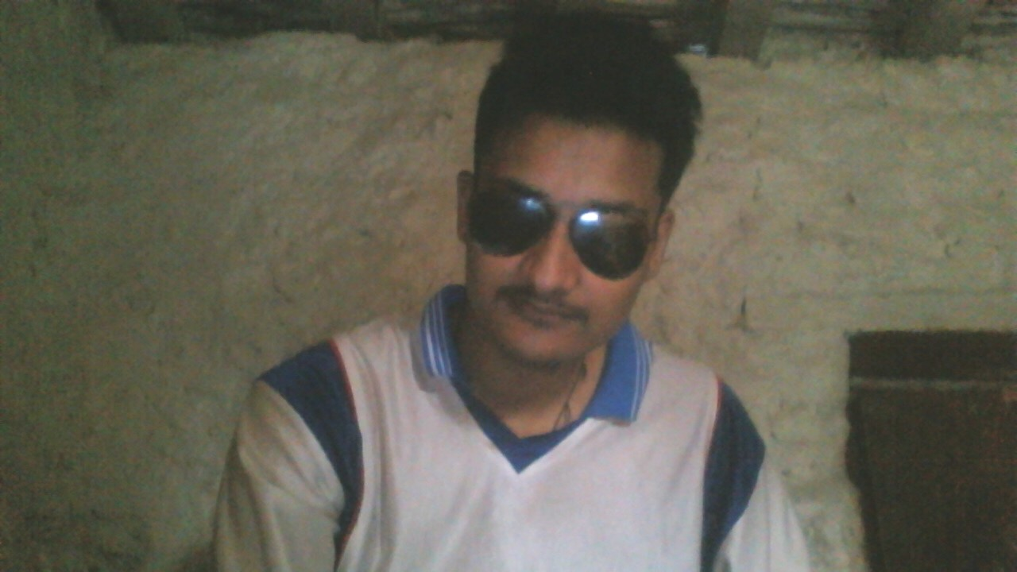
BASIC ENGLISH GRAMMAR

Slide 2

You can do at least
something into the field
if you are interested &
enthusiastic to it.
-Shailendra Jung Keshari Chand

Slide 3
Let’s start quickly
It’s a learning process.
-Shailendra Jung Keshari Chand

Slide 4








1
What is Grammar?
5
The Simple Past Tense Regular and Irregular Verbs Was and Were
The Past Progressive Tense The Future Tense
Can and Could May and Might Do, Does and Did Would and Should
98
99
104
106
108
112
113
115
120
2
The Capital Letter
6
3
8
8
13
21
23
34
Masculine and Feminine Nouns 37
Nouns
Common Nouns Proper Nouns Singular Nouns Plural Nouns Collective Nouns
8
Subject-Verb Agreement
123
9
Adverbs
127
4
Pronouns
44
44
47
48
49
Personal Pronouns Reflexive Pronouns Interrogative Pronouns Demonstrative Pronouns
10
Prepositions
132
11
Conjunctions
135
5 Adjectives
52
54
58
65
12
Interjections
138
Adjective Endings Kinds of Adjectives
Comparison of Adjectives
13
Sentences
139
139
140
141
143
144
71
71
73
74
75
What is a Sentence? Kinds of Sentences The Imperative
The Subject and the Object Direct and Indirect Objects
6 Determiners
The Articles
Demonstrative Determiners Interrogative Determiners Possessive Determiners
Positive and Negative Sentences 146
Questions 147
7
79
The Simple Present Tense 80
Am, Is and Are 83
The Present Progressive Tense 89 Have and Has 93
The Present Perfect Tense 96
14
Punctuation
150
150
151
152
152
153
Verbs and Tenses
Period Comma
Exclamation Point Question Mark Apostrophe

Slide 5
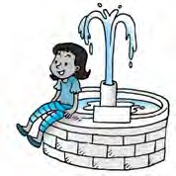
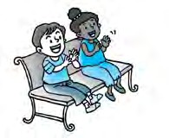
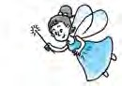
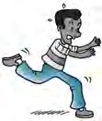
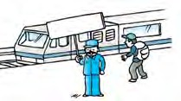
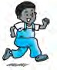
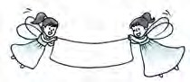
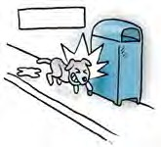
1 What is Grammar?
Here’s an old children’s rhyme about the eight parts of speech of English grammar. It gives you an idea of what grammar is about. Read and remember it.
Every name is called a noun,
As field and fountain, street and town. In place of noun the pronoun stands, As he and she can clap their hands.
The adjective describes a thing, As magic wand or bridal ring.
Most verbs mean action, something done, To read and write, to jump and run.
How things are done the adverbs tell, As quickly, slowly, badly, well.
The preposition shows relation, As in the street or at the station. Conjunctions join, in many ways,
Sentences, words, or phrase and phrase.
Pronoun
Noun
Adjective
Verb
Preposition
Adverb
The interjection cries out, “Heed!
Conjunction
An exclamation point must follow me!”
Interjection
5

Slide 6
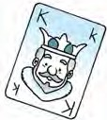
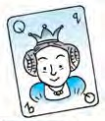
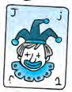
2 The Capital Letter
The capital letter is also called a big letter or upper- case letter, or sometimes just a capital.
A | B | C | D | E | F | G | H I | J | K | L | M
N | O | P | Q | R | S | T | U V | W | X | Y | Z
When do you use a capital letter?
 Use a capital letter for the first letter in a sentence:
The dog is barking.
Come here!
 Always use a capital letter for the word I : I am eight years old.
Tom and I are good friends.
 Use a capital letter for the names of people:
Alice, Tom, James, Kim, Snow White
 Use a capital letter for the names of places:
National Museum, Bronx Zoo, London, Sacramento
 Use a capital letter for festivals, holidays, days of the week, months of the year:
New Year’s Day, Christmas, Labor Day, Mother’s Day, Sunday, Monday, Friday, January, May, July, October
6

Slide 7


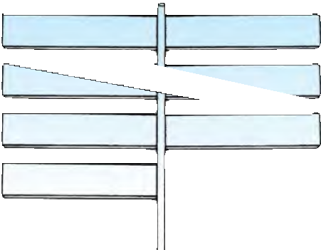
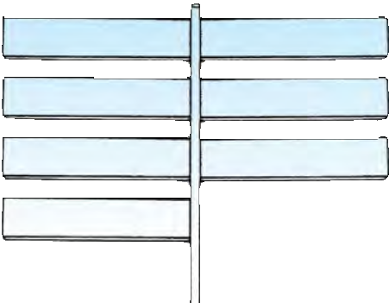
Exercise 1
Circle the letters that should be CAPITALS. Then write the correct letter in the space above them.
peter and i are good friends.
we are going to chicago during our summer vacation.
there is an interesting football game on sunday.
jason lives on thomson avenue.
5 january is the first month of the year.
Exercise 2
Look at the signs on the left. Can you find the mistakes? Write the names correctly.
hopkins hotel
lincoln school
orchard street
newton road
botanic gardens
national library
shea stadium
7

Slide 8
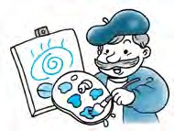
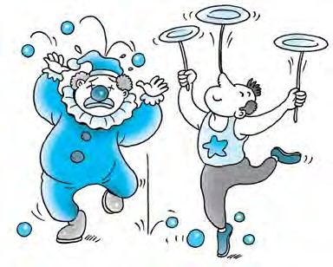
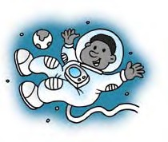



3 Nouns
common Nouns
Nouns are divided into common nouns and proper nouns. Common nouns are words for people, animals, places, or things.
These are words for people. They are common nouns.
artist
Word File
Here are more words for people:
actor aunt baby baker cook
lawyer judge man nurse
police officer
dentist singer
clown
acrobat
doctor soldier giant teacher
astronaut
i
d
y
o
u
k
n
o
Another word for astronaut is
spaceman or spacewoman.
D
w
?
8

Slide 9
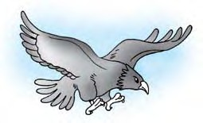
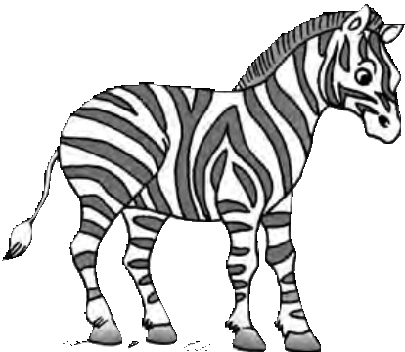
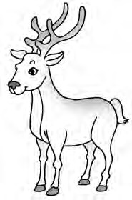

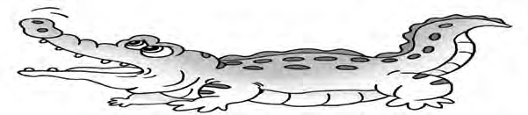
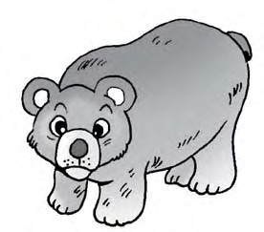
These are words for animals. They are common nouns.
eagle
zebra
deer
crocodile
bird
bear
Word File
Here are more words for animals:
cat cow dog dolphin duck fish goat
goose hen horse mouse parrot shark whale
9

Slide 10
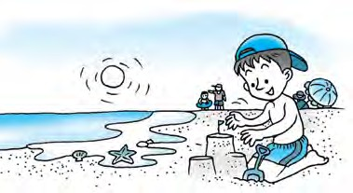
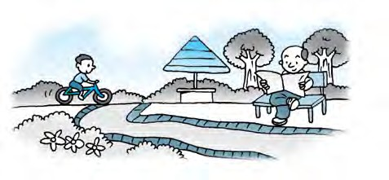
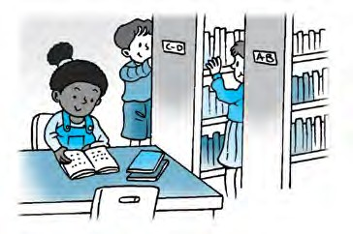
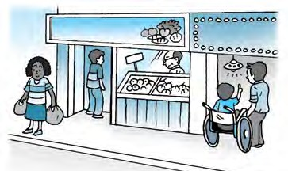
These are words for places. They are common nouns.
beach
park
Word File
Here are more words for places:
airport cave church farm hill
market mountain playground restaurant school
library
shop
Everfresh Co.
hospital seashore
hotel house island mall
stadium supermarket temple
zoo
10

Slide 11
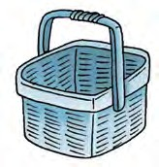
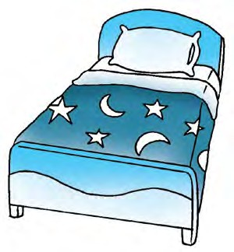
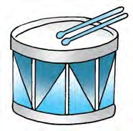
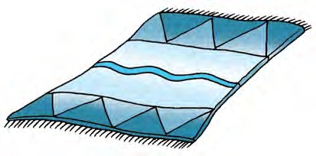
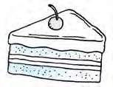
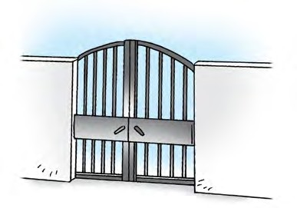
These are words for things. They are common nouns.
basket
bed
drum
cake
blanket
Word File
Here are more words for things:
bag kite
box ladder
bread lamp
can picture
chair radio
cot television
cup train
desk truck
door watch
egg window
gate
11

Slide 12






Exercise 1
Underline the common nouns in these sentences.
There’s a little bird in the garden.
Who is your teacher?
Don’t eat that rotten apple.
Kate has a lovely doll.
I like reading stories.
My father is a doctor.
Every child has a dictionary.
Rudy hates bananas.
The phone is ringing.
Here’s a book for you.
Exercise 2
Here’s a mixed bag of words. Put each word under its correct heading.
swimmer letters mountain granny
snail flag fox taxi
fire engine river
hotel gardener
clown barber parrot camel
People
Animals
Places
Things
12

Slide 13
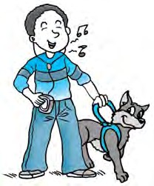
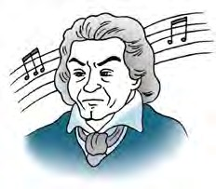
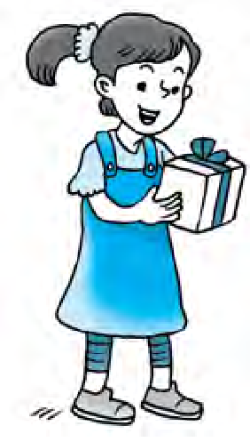
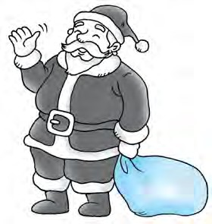




Proper Nouns
Proper nouns are names for particular people, places or things. They always begin with a capital letter.
Omar
Beethoven
Word File
Here are some more names of people:
Ali Baba
Florence Nightingale Derek Jeter
Pauline Johnny Depp Patrick
Harry Potter Pinocchio Robin Hood
Santa Claus
Lisa
i
d
y
o
u
k
n
o
Your own name and the names of your friends are proper nouns too.
D
w
Kim Lee
?
13

Slide 14
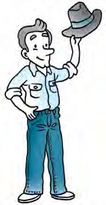
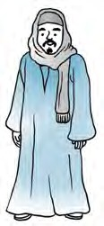
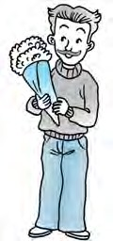

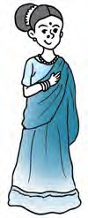
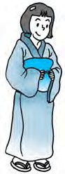
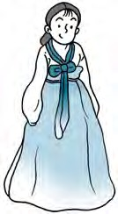
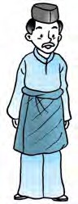
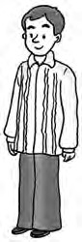
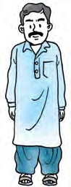




The names of countries and their people are also proper nouns.
American
Egyptian
Indian
Italian
Thai
Japanese
Korean
Malay
Filipino
Pakistani
Country | People | Country | People
America | Americans | Korea | Koreans
Egypt | Egyptians | Malaysia | Malaysians
India | Indians | Pakistan | Pakistanis
Italy | Italians | France | the French
Japan | the Japanese | Thailand | Thais
14

Slide 15
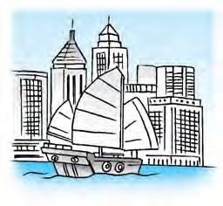
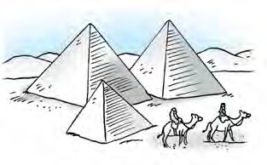
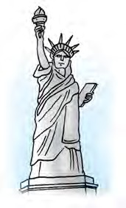
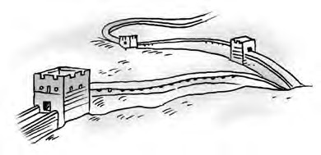
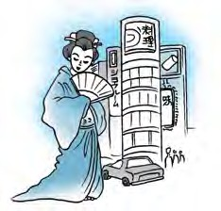

The names of towns, cities, buildings and landmarks are proper nouns.
Egypt
Hong Kong
the Great Wall of China
the Statue of Liberty
Tokyo
Sydney
Bangkok London New York Paris Beijing
New Delhi Denver Central Park the Eiffel Tower Big Ben
the Grand Canyon
the Leaning Tower of Pisa Brooklyn Bridge
Pike’s Peak
15

Slide 16







The days of the week and months of the year are proper nouns.
Days
Sunday Monday Tuesday Wednesday Thursday Friday Saturday
March
March
March
March
1
2
3
4
Sunday
Monday
Tuesday
Wednesday
March
March
March
5
6
7
Thursday
Friday
Saturday
Months January February March April May June July August
September October November December
January
February
March
April
May
June
July
August
September
October
November
December
i
d
y
o
u
k
n
o
January is the first month of the year.
Sunday is the first day of the week.
A table that shows the months, weeks days
D
w
?
and

Slide 17







The names of mountains, seas, rivers and lakes are proper nouns.
Mount Everest
the Thames
Lake Michigan the Alps
the Dead Sea Mount Fuji
the Himalayas the Pacific Ocean the Yellow River
Niagara Falls
i
d
y
o
u
k
n
o
D
w
You often use the before names of oceans, rivers, seas and ranges of mountains.
Mount means mountain.
It is often used in the names of mountains.
For example: Mount Everest
Mount St. Helens
The written short form for Mount is Mt. For example: Mt. Everest, Mt. Fuji
?

Slide 18




The names of festivals, some special events and holidays are proper nouns, too.
Valentine’s Day
Father’s Day
Halloween
Word File
Here are more names of festivals and holidays:
Christmas Memorial Day Labor Day
Mother’s Day April Fool’s Day Thanksgiving Day
New Year’s Day
Independence Day St. Patrick’s Day

Slide 19




Exercise 1
Underline the proper nouns in the following sentences.
1 July is often the hottest month in summer.
One day Ali Baba saw the forty thieves hiding in a cave.
Shawn and Ashley are going to the beach for a swim.
Mr. Lee is reading a book.
“I am your fairy godmother,” said the old woman to Cinderella.
Uncle Mike is a lawyer.
Next Tuesday is a public holiday.
Many children enjoyed the movie Lion King.
Exercise 2
Look at the words in the box. Which ones are common nouns and which ones are proper nouns? Put each word under its correct heading.
Lisa January doctor
bank beach month
President Hotel White Sand Beach Dr. Wang
United Bank hotel
girl
Common Nouns
Proper Nouns

Slide 20
Exercise 3
Write C for common or P for proper on the blank before each noun.
the White House
the green dress
the tall building
the Empire State Building
the Yellow River
the muddy river
the governor
Governor Parker
the Oregon Trail
the winding trail
Exercise 4
Underline the nouns that should be capitalized. Circle the nouns that should not be capitalized.
Robert louis Stevenson wrote treasure island.
The Capital of illinois is Springfield.
My Friends and I prefer Glittergums toothpaste.
Their Family visited Yellowstone national Park.
Juan and maria attend kennedy Middle school.
We had a Surprise Party for aunt Helen.
Spring and Fall are my favorite Seasons.
The Manager scolded his lazy Employees.

Slide 21





Singular Nouns
Nouns can be singular or plural. When you are talking about one person, animal, place, or thing, use a singular noun.
an owl
a ship
a train
a woman
Word File
These are also singular nouns:
an airplane a bicycle
a boy a bus
a comb a girl
a key
a letter a map
a photograph a refrigerator a slide
a swing a van
a flower

Slide 22


m
a
a
m
r
H
r
e
G
l
p
 Use a or an before singular nouns.
Use an before words beginning with vowels
(a, e, i, o, u). For example, say:
an axe
an egg
an envelope
an ice cream
an igloo
an orange an umbrella an uncle
 But some words don’t follow this rule. For example, use a (not an) before these words that begin with u:
a uniform a university
 Use a before words beginning with the other letters of the alphabet, called consonants. For example, say:
a basket a bowl a car
a hill
a house
a rainbow a monster a pillow
a watch
a zoo
 But some words don’t follow this rule. For example, use an (not a) before these words that begin with h:
an heir an honor an hour

Slide 23









Plural Nouns
When you are talking about two or more people, animals, places, or things, use plural nouns.
Most nouns are made plural by adding -s at the end.
star
bat
bats
stars
Word File
mug
Singular bird broom camel desk doll
egg flower fork game lamb nest pen photo shirt spoon
Plural birds brooms camels desks dolls eggs flowers forks games lambs nests pens photos shirts spoons
fan
mugs
cap
fans
caps

Slide 24













Some plural nouns end in -es.
glass
bus
brush
glasses
brushes
buses
watch
Word File Singular beach branch box
bush church dish dress sandwich witch
watches
Plural beaches branches boxes bushes churches dishes dresses sandwiches witches
foxes
fox
m
a
a
m
r
H
ch sh s ss x
+
r
e
G
l
When the last letters of singular nouns are ch, sh, s, ss or x, you usually add -es to form
the plural.
p
es

Slide 25











Some plural nouns end in -ies.
butterflies
canaries
canary
butterfly
Word File Singular baby cherry diary dictionary fairy family
fly lady library puppy story
strawberry
Plural babies cherries diaries dictionaries fairies families flies
ladies libraries puppies stories strawberries
lilies
lily
candies
candy
m
a
i +
a
m
r
H
r
e
Nouns like these are made plural by changing y to i, and adding -es.
G
l
es
p
y

Slide 26







What if there is a vowel before the y? In that case, add -s to form the plural.
y
s
key
turkey
keys
turkeys
tray
Word File Singular chimney cowboy day donkey jersey kidney monkey toy
trolley valley
Plural chimneys cowboys days donkeys jerseys kidneys monkeys toys trolleys valleys
trays

Slide 27















If a noun ends in -f, you often change f to v, and add -es.
Singular | Plural | Singular | Plural
calf | calves | loaf | loaves
elf | elves | shelf | shelves
half | halves | thief | thieves
leaf | leaves | wolf | wolves
v
es
f
m
a
a
m
r
H
r
e
f
s
G
l
p
Often nouns that end in -f, just need -s to form the plural.
Singular | Plural | Singular | Plural
chef | chefs | handkerchief | handkerchiefs
chief | chiefs | roof | roofs
cliff | cliffs | sheriff | sheriffs
For some words that end in -f, the plural can be spelled in two different ways.
Singular dwarf hoof scarf
Plural
dwarfs or dwarves hoofs or hooves scarfs or scarves
s ves
f
With some words that end in -fe, you change f to v, and add -s.
Singular
knife life wife
Plural knives lives wives
f
v e s
i
d
y
o
u
k
n
o
D
But you only add -s to giraffe to form the plural.
w
?

Slide 28






If a noun ends in -o, you just add -s to form the plural.
a rhino
rhinos
Word File
Singular a hippo a video a zoo
Plural hippos videos zoos
a kangaroo kangaroos
But with some nouns that end in -o, you add -es to form the plural.
Word File
Singular a tomato a potato a hero
Plural tomatoes potatoes heroes
a flamingo
flamingoes
m
a
a
m
r
H
r
e
G
l
With some nouns that end in -o, you can add either -s or -es to form the plural.
p
Singular | Plural | Plural
a mango | mangoes | mangos
a mosquito | mosquitoes | mosquitos
a zero | zeroes | zeros
a buffalo | buffaloes | buffalos

Slide 29









Some plural nouns don’t follow the -s rule. They don’t end in
-s, -es, -ies or -ves. Instead, the word changes form.
mouse
mice
goose
geese
Word File Singular child
man ox tooth
woman
Plural children men oxen teeth women
foot
feet
i
d
y
o
u
k
n
o
D
The plural of the mouse that you use with your computer is either mice or mouses.
w
?

Slide 30











Some plural nouns are the same as the singular noun.
sheep
sheep
reindeer
reindeer
fish
Word File
Singular bison deer
Plural bison deer
fish
i
d
y
o
u
k
n
o
D
w
You can use fishes as the plural of fish when you are talking about different kinds of fish: all the fishes of the Pacific Ocean.
?

Slide 31









Some nouns are always plural.
binoculars
goggles
Word File pants pajamas shorts trousers sandals
pliers
scissors sneakers slippers stockings
jeans
i
d
y
o
u
k
n
o
D
w
Another word for spectacles
is glasses.
spectacles
?
m
a
a
m
r
H
r
e
G
l
You can make these plural nouns singular by using a pair of:
a pair of binoculars a pair of spectacles a pair of goggles
a pair of jeans a pair of shorts a pair of pliers
a pair of shoes
p

Slide 32





Exercise 1
Look at the words below. Do you know which ones are singular and which are plural ? Put a checkmark (✓) in the correct box.
Singular Plural
word pencils books fan hat
children kites people crab foxes
Exercise 2
Do you add -s or -es to these singular nouns to make them plural? Write your answers on the lines.
Singular Plural Singular Plural
1 desk |  | 6 | basket
2 class |  | 7 | peach
3 comb |  | 8 | belt
4 mug |  | 9 | taxi
5 bus |  | 10 | box

Slide 33









Exercise 3
Do you change -y to -ies, or just add -s to make these singular nouns plural? Write your anwers.
Singular | Plural |  | Singular | Plural
1 key |  | 6 | toy
2 city |  | 7 | baby
3 butterfly |  | 8 | party
4 monkey |  | 9 | chimney
5 fly |  | 10 | lady
Exercise 4
All these singular nouns end with -o. Add either -s or -es
as you write the plurals on the line.
Singular |  | Plural |  | Singular | Plural
1 video |  |  | 6 | radio
2 piano |  |  | 7 | hippo
3 mango |  |  | 8 | zoo
4 | kangaroo |  | 9 | zero
5 | rhino |  | 10 | photo

Slide 34




Collective Nouns
Collective nouns are words for groups of people, animals or things.
These are nouns for groups of people.
a family
a crew
an orchestra
Word File
Here are some more groups of people:
an audience a band
a choir a class
a gang a group a team
m
a
a
m
r
H
r
e
G
l
Many collective nouns can be used with a singular or plural verb.
For example:
My family was happy to see me. or
My family were happy to see me.
But the following collective nouns always take a plural verb: cattle people the police
p

Slide 35





Here are more collective nouns that are used for groups of people, animals or things.
a brood of chickens
a band of musicians
Word File
Here are some more collective nouns:
a bunch of keys a class of pupils
a collection of books a deck of cards
a fleet of ships a flock of sheep
a gaggle of geese a gang of robbers a herd of cattle
a litter of cubs
a pod of whales a pack of wolves a pride of lions
a set of stamps a swarm of bees
a troupe of actors
a school of fish
a team of players
a flight of steps

Slide 36


Exercise
Farmer John had several different kinds of animals on his farm. Write the correct collective noun for each group of his animals.
Farmer John had:
a of geese a of sheep a of cattle a of horses
One day a of coyotes tried to attack his animals. Farmer John yelled and waved a pitchfork to frighten them
away.
36

Slide 37




Mas culine and Feminine Nouns
Masculine nouns are words for men and boys, and male animals.
Feminine nouns are words for women and girls, and female animals.
rooster
bride
bridegroom
hen
lion
lioness
Word File Masculine boy
man prince steward waiter
Feminine girl woman princess
stewardess waitress
king
queen
37

Slide 38




Here are some more masculine and feminine nouns for people.
Masculine
Feminine
actor brother emperor father gentleman grandfather grandson headmaster man master nephew prince
son steward uncle wizard
actress sister empress mother lady
grandmother granddaughter headmistress woman mistress
niece princess daughter stewardess aunt
witch
d
y
o
u
k
Masculine nouns belong to the
masculine gender.
Feminine nouns belong to the
feminine gender.
i
n
o
D
w
?

Slide 39




Here are some masculine and feminine nouns for male and female animals.
Animal
Male
Female
chicken | rooster | hen
cattle | bull | cow
deer | buck | doe
donkey | jack | jenny
duck | drake | duck
fox | fox | vixen
goose | gander | goose
horse | stallion | mare
lion | lion | lioness
sheep | ram | ewe
tiger | tiger | tigress
i
d
y
o
u
k
n
o
D
w
Nouns that end in -ess and -ress often belong to the feminine gender. For example:
?
actress lioness princess
stewardess tigress waitress

Slide 40





Many nouns are used for both males and females.
dancers
doctors
scientists
Word File
Nouns like these are used for both males and females:
accountants artists designers engineers lawyers
parents managers pupils singers teachers
hairdressers
m
a
a
m
r
H
r
e
We call these nouns common-gender nouns.
G
l
p

Slide 41





Words for things that are neither male nor female are called neuter nouns.
leaves
bench
fire
mirror
waterfall
Word File
Here are some neuter nouns:
ball building broom cake computer card
floor
forest gymnasium playground rock
sky socks wind

Slide 42


Exercise 1
Fill in the blanks with the correct masculine or
feminine nouns.
Masculine
master
uncle
3
4
5 tiger
6
husband
son
9
10
Feminine
niece
lioness
empress
mother madam
Exercise 2
Fill in each blank with a suitable masculine or feminine
noun.
The host and the welcomed their guests.
The steward and the look after the passengers on the plane.
My uncle and lived in Nebraska.
The king and the had two children, a boy and a . The prince was eight and the
was five.
Ladies and , welcome to our party this evening.

Slide 43




Exercise 3
Look at the words in the box. Write each word under its correct heading.
children boy mother lamp ram
sun son queen doctor rooster
witch father file dancer elf
king girl teacher wizard fish
Masculine
Feminine
Common Gender
Neuter

Slide 44


4 Pronouns
A pronoun is a word that takes the place of a common noun or a proper noun. There are different kinds of pronouns.
Personal Pronouns
The words I, you, he, she, it, we and they are called personal pronouns. They take the place of nouns and are used as the subject of the verb in a sentence.
My name is David. I am the youngest in the family. This is my father. He is a teacher.
This is my mother. She is a lawyer.
I have a brother and two sisters. They are Peter, Sharon and Jenny. I have a dog. It is called Lucky.
Lucky, you are a good dog.
Good morning, children! You may sit down now.
My family and I live in a big city. We have an apartment.
m
a
a
m
r
H
r
e
The subject of a sentence is the person, animal, place or thing that does the action shown by the verb.
G
l
p

Slide 45




The words me, you, him, her, it, us and them are also personal pronouns. They also take the place of nouns.
These pronouns are used as the object of the verb in a sentence.
I am standing on my head. Look at me. My mother is kind. Everybody likes her. Lisa, I told you to tidy your bed!
Sharon and Jenny! Dad is waiting for you!
Lucky and I are playing in the park. Dad is watching us. You must not play with the knife. Give it to me.
Pick up your toys and put them away.
Baby birds cannot fly.
Mother bird has to feed them.
Tom likes riding my bicycle. I sometimes lend it to him.
m
a
a
m
r
H
r
e
The object of a sentence is the person, animal, place or thing that receives the action shown by the verb.
G
l
p

Slide 46


m
a
a
m
r
H
r
e
G
l
p
There are three groups of pronouns: first person, second person and third person.
The person speaking is called the first person.
The first-person pronouns are I or me (in the singular) and
we or us (in the plural).
The person spoken to is called the second person. The second-person pronoun is you (in both singular and plural).
The person (or animal, or thing) spoken about is called the third person. The third-person pronouns are he or him, she or her, and it (in the singular), and they or them (in the plural).
The word I is always spelled with a capital letter. The pronoun he is used for men and boys, she for women and girls, and it for things and animals.
Here is a table to help you.
 | Subject | Object
First person singular | I | me
Second person singular | you | you
Third person singular | he she it | him her it
First person plural | we | us
Second person plural | you | you
Third person plural | they | them

Slide 47

Reflexive Pronouns
The words myself, yourself, himself, herself, itself, ourselves, yourselves and themselves are called reflexive pronouns.
They refer to the person or animal that is the subject of the verb.
I made this cake myself.
Be careful with the knife. You’ll cut yourself. Michael is looking at himself in the mirror. Susan has hurt herself.
Our cat washes itself after each meal.
We organized the party all by ourselves. Come in, children, and find yourselves a seat.
Baby birds are too young to look after themselves.
m
a
a
m
r
H
r
e
G
l
Here is a table to remind you about reflexive pronouns.
p
 | Singular | Plural
First person | (I,me) myself | (we,us) ourselves
Second person | (you) yourself | (you) yourselves
Third person | (he, him) himself (she, her) herself (it) itself | (they, them) themselves (they, them) themselves (they, them) themselves

Slide 48






Interrogative Pronouns
The words who, whom, whose, what and which are called interrogative pronouns.
These pronouns are used to ask questions.
Who
Who is he talking to?
Who are those people?
Whom
Whom are you playing with?
Whom is he talking to?
Which
Which of these bags is yours?
Which do you prefer?
Whose
Whose is this umbrella?
Whose are these gloves?
What
What is your dog’s name? What are you talking about? What is the time?
Who can be used as the object of a verb as well as the subject.
Whom is used only as the object. For example, you can say:
Who are you playing with? or
Whom are you playing with?
m
a
a
m
r
H
r
e
G
l
p

Slide 49


Demonstrative Pronouns
The words this, these, that and those are called
demonstrative pronouns. They are showing words.
Those are goats.
That is John’s house. That is a mountain. Those are horses.
What are those? We can do better than that.
No, that’s not mine. You mean you won? That’s amazing!
Hello, who is that speaking, please? Hello, is that you, George?
These are sheep.
This is my house.
This is a hill.
These are donkeys. What is this?
Did you drop this?
Hi, Jane! This is Michael!
m
a
a
m
r
H
r
e
You use this and these when you point to things
near you.
You use that and those when you point to things
farther away.
Demonstrative pronouns can be singular or plural:
G
l
p
Singular
this that
Plural these those

Slide 50
Exercise 1
Draw a line to join each of the subject pronouns
to the object pronoun that matches.
I he it she they you
we
us her you them me
Exercise 2
Fill in the blanks with the correct pronouns.
him
it
Peter and I are brothers. share a bedroom together.
Sue isn’t well. Dad is taking to see a doctor.
My brother is a teacher. teaches English.
All his students like very much.
Children, are making too much noise!
Who are those people? Where are from?
Mom is a doctor. works in a hospital.
The sky is getting dark. is going to rain.
John, we are all waiting for . Are you coming with ?
10 May borrow your pen?
Yes, of course. When can you return to
?
What are reading, Jenny?

Slide 51
Exercise 3
Fill in the blanks with the correct reflexive pronouns
from the box.
yourselves himself
themselves yourself
itself ourselves
myself herself
No one can help us. We have to help .
Jane always makes the bed by .
They painted the wall all by .
I hurt in the playground yesterday.
John, you must behave before your friends.
Children, you must do the homework .
Tom defended against the bullies.
The dog is scratching .
Exercise 4
Write the correct interrogative pronouns in the blanks to complete the sentences:
1 is the matter with you? 2 invented the computer? 3 of the twins is older?
do you wish to speak to?
is this car in front of our house? 6 knows the answer?
7 came first, the chicken or the egg? 8 would you like to drink?
9 of them do you think will win the race? 10 is the word for a stamp collector?

Slide 52




5 Adjectives
An adjective is a describing word. It tells you more about a noun. An adjective usually appears before the noun
it describes. Sometimes, though, the adjective appears after the noun, later in the sentence.
a smart dog
an old building
a busy street a dark corner a deep sea
a large bed It is windy.
John’s handwriting is very neat.
The sea is rough.
All the players are very tall.
The baby’s hands are very small. Sue’s drawing is beautiful.
That problem is too difficult. Peter is very quiet today.
a tall basketball player
a low fence

Slide 53


Exercise 1
Underline the adjectives in the following sentences.
There is an empty room upstairs.
It’s a hot summer.
You are so kind.
Don’t be crazy.
This park is clean and green.
Many people exercise to keep healthy.
I think these eggs are rotten.
We are all bored. There isn’t anything to do.
The pupils don’t find the joke amusing.
James was absent because he was ill.
Exercise 2
Fill in the blanks with suitable adjectives from the box.
hot high
large sweet
short poor
free playful
The ice cream is very .
It’s very in summer.
The company is giving away gifts to its customers.
They live in a house.
Jean is wearing a skirt.
The climbers are climbing up a mountain.
These puppies are very .
Many people have no home.

Slide 54






Adjective Endings
Adjectives have different endings. Some adjectives end in -ful or -less.
a beautiful dress a careless driver a faithful dog
a harmless insect a useful tool
homeless people
playful puppies
m
a
a
m
r
H
r
e
G
l
p
An adjective that ends in -less is the opposite of the same adjective that ends in -ful.
For example:
careful | – careless | useful – | useless
colorful | – colorless | harmful – | harmless
The -ful ending means having a lot of something. For example:
painful | = | having a lot of pain
hopeful | = | having a lot of hope
The -less ending means without. For example:
leafless | = | without leaves
sleeveless | = | without sleeves

Slide 55






Some adjectives end in -y.
a dirty street a noisy room an oily pot
a sleepy passenger a sunny day
a stormy sea
a muddy path
Some adjectives end in -ive.
an expensive necklace
an active child an attractive hat a creative toy
talkative pupils
Some adjectives end in -ing.
a caring nurse
an interesting book loving parents matching clothes
a smiling face
a cunning fox
dazzling sunshine

Slide 56







Some adjectives end in -ly.
a costly diamond ring an elderly woman lively kittens
a lonely boy a lovely girl
a weekly magazine
a daily newspaper
a friendly police officer
m
a
a
m
r
H
r
e
G
l
Many adverbs also end in -ly.
Here are some adjectives with the endings -able, -al,
-en, -ible, -ish and -ous.
a broken chair
p
a famous pop singer
childish behavior
a comfortable chair a dangerous place a foolish act
a horrible smell a loveable koala
a national costume a musical instrument a terrible mess
a woolen sweater a wooden table
a poisonous snake
56

Slide 57
Exercise 1
Add the correct endings to turn these words into adjectives.
-y
-ful
-less
-al
peace
storm
mud
forget
6 dirt
7 music
8 nation
9 dust
5 spot 10 play
Exercise 2
Add the correct endings to turn these words into adjectives.
-en
-ish
-y
-ous
-ing
-ly
1 wind
6 fool
2 gold
7 charm
3 friend
8 child
rot
danger
love
interest

Slide 58





Kinds of Adjectives
There are different kinds of adjectives.
Some adjectives describe the qualities of nouns.
a cold drink
a hot bun
an ugly monster
a fierce dog
a beautiful rainbow a clever monkey
a difficult question
happy children a kind lady
a new car an old house a pretty girl a rich family a sad story
a strong man
a wicked queen
a loud crash

Slide 59





Some adjectives tell you which place or country a person or thing comes from, or belongs to. They are called adjectives of origin.
Chinese kungfu
an Indian temple
a Mexican hat
Dutch clogs
Australian apples a Balinese dancer
the English language the French flag
an Italian car
a Japanese garden a Scottish kilt
Thai boxing
A Filipino shirt

Slide 60



Some adjectives tell you the color of things.
Please get me some white paint.
The sky is gray.
The sea is blue.
George is wearing brown shoes. I don’t like green apples.
Carrots are orange. Flamingos are pink. Eggplants are purple. Roses are red.
Your hands are black!
60

Slide 61







Some adjectives tell you the size of the nouns they describe.
a big hat
broad shoulders a high mountain a large ship
a long bridge a low ceiling a narrow path small animals tiny insects
a wide street
a huge balloon
a fat sumo wrestler
a thin boy
a short man
i
d
y
o
u
k
n
o
D
w
The word tall describes people and narrow, upright objects. For example, you can say:
a tall girl a tall bookcase
The word high describes bigger or wider objects that reach a great height. For example, you can say:
a high mountain a high wall
?

Slide 62










Numbers are adjectives, too. They tell you how many people, animals, or things there are. Sometimes they are called adjectives of quantity.
two princes
three princesses
one giant
four mermaids
five witches
seven elves
six fairies
nine dwarfs
eight puppets
ten angels
eleven hens | fifteen frogs | nineteen lizards
twelve geese | sixteen snails | twenty butterflies
thirteen birds | seventeen kittens
fourteen mice | eighteen ants

Slide 63






Other adjectives tell you something about quantity without giving you the exact number.
some soldiers
a little ice cream
a little rice
not many people too much salt lots of insects plenty of money
some food
Is there any milk?
a lot of books
a few cups
a few puppies
Adjectives that tell you about quantity are also called quantifying determiners.
i
d
y
o
u
k
n
o
D
w
?

Slide 64
Exercise
Look at the underlined words in the following sentences. Do you know what kinds of adjectives they are?
In the blanks write C if the underlined words tell you about color, S if they tell you about size, Ql if they tell you about quality, O if they tell you about origin, or Qn if they tell you about the number or quantity of things.
1 Dad has two pairs of shoes.
2 One pair is brown and the other pair is black.
3 This is a very simple puzzle.
4 What color is the American flag?
5 A kind fairy appeared before Cinderella.
6 He is a proud man.
7 There is some food left.
8 Tom is wearing a blue T-shirt.
9 Jack has ten marbles; Peter has twenty.
10 How many marbles have Jack and Peter altogether?
11 There is an Indian temple in the city.
12 There is a large crowd outside the temple.
13 My house is just a few miles from the school.
14 They are driving a small car.
15 Sue likes those yellow and red balloons.

Slide 65







Comparison of Adjectives
When you compare two people or things, use the
comparative form of the adjective.
Lots of comparative adjectives end in -er.
fast faster
small
smaller
bright
cheap clear loud new old rich short tall slow thick
cheaper clearer louder newer older richer shorter taller slower thicker
brighter
m
a
a
m
r
H
r
e
The word than is often used with comparative adjectives. For example, you might say:
Jack is taller than John.
A sports car is faster than a motorbike.
G
l
p

Slide 66





Use the superlative form of an adjective to compare three or more nouns. Lots of superlatives end in -est.
dark
darker
darkest
thick
thicker
thickest
long longer
longest
m
a
a
m
r
H
r
e
G
l
You often add the before the superlative form. For example, you say:
Mount Everest is the highest mountain in the world.
Peter is the tallest boy in his class.
p

Slide 67


m
a
a
m
r
H
r
e
G
l
p
 With adjectives that end in -e, add -r to form
the comparative, and -st to form the superlative. For example:
 | Comparative | Superlative
close | closer | closest
large | larger | largest
safe | safer | safest
wide | wider | widest
 Some adjectives have only one syllable, end with a consonant, and have a single vowel before the consonant. With these adjectives, double the last letter before adding –er to form the comparative, and -est to form the superlative. For example:
 | Comparative | Superlative
big | bigger | biggest
dim | dimmer | dimmest
mad | madder | maddest
sad | sadder | saddest
 Some adjectives have two syllables and end in -y. With these adjectives change the y to i. Then add -er to form the comparative, and -est to form the superlative.
For example:
 | Comparative | Superlative
busy | busier | busiest
dirty | dirtier | dirtiest
happy | happier | happiest
pretty | prettier | prettiest

Slide 68





With some adjectives, you use more to make the comparative form, and most to make the superlative form.
beautiful
more beautiful
most beautiful
active | more active | most active
charming | more charming | most charming
cheerful | more cheerful | most cheerful
comfortable | more comfortable | most comfortable
delicious | more delicious | most delicious
i
d
y
o
u
k
n
o
D
w
Adjectives that form their comparative and superlative with more and most are usually adjectives with two or more syllables, or sounds. For example:
?
ac-tive beau-ti-ful charm-ing cheer-ful
com-fort-a-ble de-li-cious
ex-pen-sive fa-mous
for-tu-nate in-tel-li-gent pow-er-ful val-u-a-ble

Slide 69






The comparative and superlative forms of some adjectives are completely different words.
good
better
best
little
less
least
m
a
a
m
r
H
r
e
G
l
With these adjectives, you don’t add -er or more to form the comparative, or -est or most to form the superlative.
p

Slide 70




Exercise 1
Fill in the blanks with the correct comparative and
superlative forms of the following adjectives.
 | Comparative | Superlative
hard
cold
soft
tall
rich
mad
funny
big
sad
busy
noisy
Exercise 2
Fill in the blanks with the correct comparative and
superlative forms of the following adjectives.
 | Comparative | Superlative
foolish
harmful
poisonous
valuable
difficult
generous

Slide 71




6 Determiners
Determiners are words such as this, those, my, their, which. They are special adjectives that are used before nouns.
The Articles
The words a, an and the belong to this group of words called determiners.
The words a and an are called indefinite articles. You can use them with singular nouns to talk about any single person or thing.
Can you hear a
bird singing ?
This is a picture of an elephant. Rudy is reading a book.
Mom bought me a new dress today.
You will need an umbrella when you go out. She eats an apple a day.
Do you wear a
uniform to school?
m
a
a
m
r
H
r
e
The article an is usually used before words beginning with vowels. The article a is used before words beginning with consonants.
G
l
p

Slide 72






The word the is called the definite article. Use the before a noun when you are talking about a certain person or thing.
The telephone is ringing.
Where’s the cat?
I think she is under the bed.
Tom has won the race.
Granny is sitting in the garden.
The street is very busy today.
The sky is getting dark.
The ice is melting.
m
a
a
m
r
H
r
e
G
l
You also use the before a noun when there is only one. For example:
the sun the moon the sky
the front door of my house
p

Slide 73





Demonstrative Determiners
The words this, that, these and those are determiners. They are used to tell which thing or person you mean. These words are called demonstrative determiners, or demonstrative adjectives.
I am keeping these books. I am selling those books.
This ice cream is delicious. How much is that racket? What is that animal?
Bring me that ball.
James lives in this house.
Would you like these apples?
You use this and these to point to people or things near you.
You use that and those to point to people or things that are
farther from you.
You use this and that before singular nouns. You use these and those before plural nouns.
Here’s a table to help you remember the rules:
m
a
a
m
r
H
r
e
G
l
p
Singular
this that
Plural these those

Slide 74



Interrogative Determiners
Use the words what, which and whose before nouns to ask about people or things. These words are called interrogative determiners or interrrogative adjectives.
What size do you wear? What kind of bird is that?
What time is it?
What color is her hair?
What kind of clothes do you like to wear?
Which school do you go to? Which doll is your favorite? Which road leads to the zoo? Which runner is the winner?
Do you know which girl won the prize?
Whose footprints are these?
Whose baby is this?
Whose dog was barking in the middle of the night?
what
which
whose

Slide 75





Possessive Determiners
The words my, your, his, her, its, our, their are called possessive determiners or posessive adjectives. Use these words before nouns to say who something belongs to.
I lent Margaret my guitar.
Is this your house?
Robert, your handwriting is difficult to read. Michael is showing his tortoise to his friends. My sister lost her way in the city.
The lion is chasing its prey.
The dentist asked his patient to open her mouth.
m
a
a
m
r
H
r
e
G
l
Here is a table to help you remember the
possessive determiners.
p
 | Singular | Plural
First person | my | our
Second person | your | your
Third person | his her its | their their their
75

Slide 76
Exercise 1
Fill in the blanks with a, an or the.
owl
rocket
apron
sun
page
computer
moon
Missouri River 9 mango
animal
eagle 12 baby
Exercise 2
Write a, an or the in the blanks to complete the sentences.
There is rainbow in sky.
Who is man outside gate?
doctor gave Jane injection.
Paul opened door to let dog in.
Mark is only child in family.
What’s largest animal in world?
There’s nest in tree.
Sue is writing letter to her grandfather.
Jack has brother and sister.
We reached top of hill in two hours.
76

Slide 77
Exercise 3
Fill in the blanks with the correct demonstrative adjectives.
Come and look at insects.
Stop man!
I was in fifth grade last year. I am in sixth grade
year.
Bring chairs here.
ice cream is delicious.
Can you see stars in the sky?
Exercise 4
Are the underlined words demonstrative adjectives or demonstrative pronouns? Write DA (for demonstrative adjectives) or DP (for demonstrative pronouns) in the blanks.
1 This house has five bedrooms.
2 Who is that man?
3 This is our school.
4 These are wild animals.
5 That is right.
6 What’s that noise?
7 These books are Jane’s.
8 Those books belong to me.
9 These are donkeys.
10 Those are horses.
77

Slide 78
Exercise 5
Choose the correct possessive adjectives from the box to fill in the blanks.
my its
his our
your her
their
Is this Jane’s dog? Yes, this is dog.
The dog is chasing own tail.
Peter, is father at home?
Rudy is showing stamps to Ali.
I am going to aunt’s house this evening.
We always keep classroom clean.
Children, have you all finished homework?
The children are proud of school.
Exercise 6
Choose the correct interrogative adjectives from the box to fill in the blanks.
what which whose
kind of animal is that?
runner is the winner?
is the matter?
desk is this?
handphone is ringing?
is your name?
twin is taller?
hand is holding the pebble?
78

Slide 79






7 Verbs and Tenses
Most verbs are action words. They tell you what people, animals or things are doing.
knock
burst
climb
dig
read
Word File
act jump
bake move
bend pull
buy run
close shout
cook sing
cross sit
fall slide
fly stand
go start
grow swim
hop walk
drop
79

Slide 80




The Simple Present Tense
The simple present tense expresses a general truth or a customary action.
The sun rises in the east.
Uncle Joe wears glasses.
Ducks love water.
The children go to school by bus.
Mary enjoys singing.
Peter sometimes lends me his bike. Cows eat grass.
Monkeys like bananas. Tom collects stamps.
The earth goes around the sun. It often snows in winter.
We always wash our hands before meals. We eat three meals a day.
Father takes the dog for a walk every morning.
80

Slide 81



Use the simple present tense to talk about things that are planned for the future.
Melanie starts
school tomorrow.
Next week I go to summer camp.
The train departs
in five minutes.
We join the senior scout troop in July this year. My big brother leaves school at 4 o’clock.
The new supermarket opens next Friday.
The new grammar book comes out in September. Grandad retires next year.
We fly to London next Thursday. The plane lands at 5:30 P.M.
We move to our new house in a month.
My big sister begins her summer job next week.
81

Slide 82
Exercise 1
Underline the verbs in the following sentences.
The children go to school by bus.
Bats sleep during the day.
These toys belong to Kathy.
Every pupil has a good dictionary.
Polar bears live at the North Pole.
Most children learn very fast.
Mr. Thomas teaches us science.
The earth goes around the sun.
We never cross the street without looking.
Many stores close on Sunday.
Exercise 2
Fill in the blanks with the simple present tense of the verbs in parentheses.
Winter after autumn. (come)
A dog . (bark)
You tired. (look)
Everyone mistakes. (make)
Ali in a department store. (work)
Judy English very well. (speak)
Tim’s knee . (hurt)
Monkeys bananas. (like)
Kate always sandwiches for lunch. (eat)
He very fast. (type)
82

Slide 83



Am, Is and Are
The words am, is, are are also verbs, but they are not action words. They are the simple present tense of the verb be.
Use am with the pronoun I, and is with the pronouns he, she and it. Use are with the pronouns you, we and they.
It is a donkey. It is not a horse.
It is very hot today.
It is not very comfortable.
the verb ‘be’
am is are
I am Peter. I am not Paul.
She is Miss Lee. She is a teacher.
He is my father. He is a doctor. He is not a lawyer. You are a stranger. You are not my friend.
We are in the same class, but we are not on the same team. They are good friends. They are not enemies.
83

Slide 84


m
a
a
m
r
H
r
e
G
l
p
Here’s a table to help you remember how to use am, is and are:
 | Singular | Plural
First person | I am | we are
Second person | you are | you are
Third person | he is she is it is | they are they are they are
Learn these short forms called contractions:
I am | = | I’m | they are | = | they’re
you are | = | you’re | we are | = | we’re
he is | = | he’s
she is | = | she’s
it is | = | it’s
am not | = | aren’t (only in questions)
is not | = | isn’t
are not | = | aren’t
In questions, use aren’t as a contraction of am not. For example, you can say:
I’m taller than you, aren’t I?
But in a statement you say:
I’m not as old as you.
84

Slide 85




Use the verb is with singular nouns and are with plural nouns.
The camel is a desert animal.
Vegetables and fruit
are healthy foods.
Lambs are baby sheep.
Singular nouns
is
Plural are
nouns
Kenneth is a lawyer. Rex is a clever dog.
A duck is a kind of bird.
The playground is full of people today. My house is near the school.
These questions are too difficult. The balloons are very colorful.
Those people are very busy.
Dad and Mom are in the kitchen.
85

Slide 86




Use is and are with the word there to say what you can see and hear.
There is a castle on the hill.
There are some clouds in the sky.
There is a wasps’ nest in the tree.
There is a fence around the school.
There are a lot of books in the library.
There are two guards at the gate.
Is there any food in the fridge?
Are there any apples left on the tree? How much rice is there?
There are a few sharks in the bay.
There are enough candies for everyone, aren’t there? There are two pigeons on the roof.
m
a
a
m
r
H
r
e
Learn this contraction: there is = there’s
G
l
p
86

Slide 87
Exercise 1
Fill in the blanks with am, is or are.
They my good friends.
He a soldier.
You taller than Charlie.
She ill.
We very hungry.
It a sunny day.
I angry with Joe.
You all welcome to my house.
Exercise 2
Fill in the blanks with is or are.
John’s dog very friendly.
Robert ten years old.
These flowers very pretty.
The two schools close to each other.
Math not a very difficult subject.
dinner ready?
This computer very easy to use.
All the windows open.
Sue and Jane neighbors.
His hair curly.
87

Slide 88
Exercise 3
Fill in the blanks with There is or There are.
a fence around the barn.
trees along the road.
a rainbow in the sky.
lots of parks in our town.
nothing in the cupboard.
not many bedrooms in the new house.
lots of mistakes on your test paper.
a wasps’ nest in the tree.
ants in the cookies.
many different kinds of animals in the zoo.
plenty of food on the table.
a church on the hilltop.
no more water in the pool.
too many people on the beach.
only a few customers in the shop.
88

Slide 89

The Present Progressive Tense
When do you use the present progressive tense? To talk about actions in the present, or things that are still going on or happening now.
I am writing
a letter.
Mom is knitting a sweater for Sally.
The phone is ringing.
I’m playing chess with my friend. She’s riding a horse.
He’s taking a walk in the park.
The man’s counting the money. They are practicing tai chi.
We’re rushing to the airport to meet Mr. Smith. They are still sleeping.
They are swimming in the sea. What are they doing?
What’s happening?
Why aren’t you doing your homework?
Aren’t I sitting up straight?
89

Slide 90



m
a
am
+
a
m
r
H
r
e
is
verb ing
G
l
p
are
 Form the present progressive tense like this:
am | + | present participle
is | + | present participle
are | + | present participle
 The present participle is the form of a verb ending with
-ing. For example:
show | + | ing = | showing
come | + | ing = | coming
 You have to double the last letter of some verbs before you add -ing. For example:
get + | ing | = getting | rob + ing = | robbing
nod + | ing | = nodding | stop + ing = | stopping
jog + | ing | = jogging | swim + ing = | swimming
 Notice that the verbs above are all short verbs of just
one syllable.
They all end with a consonant such as b, d, g, m, p, t
and have only one vowel before the consonant.
 If a verb ends in e, you usually have to drop the e
before you add -ing. For example:
chase | + | ing | = | chasing
cycle | + | ing | = | cycling
drive | + | ing | = | driving
smile | + | ing | = | smiling
90

Slide 91


Use the present progressive tense to talk about things you have planned to do, or things that are going to happen in the future. To form the present progressive tense, use am, is and are as helping verbs or auxiliary verbs.
When are you taking
me to the zoo?
We are having a barbecue later this evening.
We are going camping tomorrow. I’m starting piano lessons soon.
Jim’s parents are taking him to Texas next week. My favorite TV program is starting in a minute.
All our friends are coming.
Who’s bringing salad for the barbecue? I am. I am visiting Joe next week.
Where are you going for your vacation? What are we eating for dinner?
91

Slide 92
Exercise 1
Write the present participle of these verbs on the blanks.
1 come |  | 7 | go
2 run |  | 8 | ask
3 sleep |  | 9 | catch
4 fall |  | 10 | write
5 jump |  | 11 | drop
6 climb |  | 12 | bring
Exercise 2
Fill in the blanks with the present progressive tense of the verbs in parentheses.
They the roller-coaster ride. (enjoy)
Jill her hair. (wash)
It dark. (get)
The dentist Sue’s teeth. (examine)
The train through the tunnel. (pass)
The men very hard in the sun. (work)
What the theater today? (show)
We a snowman. (make)
The plane above the clouds. (fly)
The teachers a meeting. (have)
92

Slide 93



Have and Has
The verbs have and has are used to say what people own or possess. They are also used to talk about things that people do or get, such as illnesses. These words are the simple present tense of the verb have.
Peter has a sore knee.
We have breakfast at 7:00 A.M.
He has a lot of stamps. She has long hair.
Our house has large windows. I have a younger brother.
We have art lessons on Mondays.
Have a cookie, if you like. Dad has a cold.
Jenny often has sandwiches for lunch.
Monkeys have
long tails.
93

Slide 94



m
a
a
m
r
H
r
e
G
l
p
Use has with he, she, it, and with singular nouns. Use
have with I, you, we, they, and with plural nouns.
Here is a table to help you remember the rules:
 | Singular | Plural
First person | I have | we have
Second person | you have | you have
Third person | he has she has it has | they have they have they have
Learn these contractions:
I have | = I’ve
you have | = you’ve
he has | = he’s
she has | = she’s
it has | = it’s
we have | = we’ve
they have | = they’ve
have not | = haven’t
has not | = hasn’t
94

Slide 95
Exercise 1
Fill in the blanks with have or has.
We a new science teacher.
He a bad temper.
I often fruit for dessert.
You a good chance of winning the prize.
She always oatmeal for breakfast.
The broom a blue handle.
They never any problem with tests.
Exercise 2
Fill in the blanks with have or has.
The girls golden hair.
An insect six legs.
Dad his cell phone with him.
The children a new swing set.
Many poor people nothing to eat.
Chicago a very big airport.
A triangle three sides.
The man two daughters.
James a toothache.
All the passengers their tickets.
95

Slide 96



The Present Perfect Tense
Use the present perfect tense to talk about happenings in the past that explain or affect the present. The verbs have and has are used as “helping” or auxiliary verbs to form the present perfect tense.
Sam has scored two goals. I’ve just finished my shower. Uncle Tom has lost his wallet. John has gone out.
The Lees have moved to Ohio. It has not rained for months.
Have you found your keys yet?
Tim has made two spelling mistakes. They have opened a new shop.
It’s been very wet today.
Kim’s cut
her finger.
m
a
a
m
r
H
r
e
G
l
To form the present perfect tense join have or
has to the past participle of the verb:
p
have | + | past participle
has | + | past participle
The past participle of a regular verb usually ends in -ed, just like the simple past tense. But the past participles of irregular verbs don’t follow this rule.
96

Slide 97
Exercise 1
Write the past participle of these verbs on the blanks.
1 break |  | 6 | buy
2 drink |  | 7 | find
3 cut |  | 8 | draw
4 do |  | 9 | hear
5 sing |  | 10 | know
Exercise 2
Fill in the blanks with the present perfect tense of the verbs in parentheses.
Dad his car key. (lose)
All the guests . (arrive)
Tony a goal. (score)
Peter in the tent several times. (sleep)
It not for two months. (rain)
Some prisoners from the prison. (escape)
The plane at the airport. (land)
John a puppet. (make)
Dad and I a big fish. (catch)
I this movie twice. (see)
97

Slide 98



The Simple Past Tense
Use the simple past tense to talk about things that happened in the past. The simple past tense is also used to talk about things that happened in stories.
The wicked Queen gave
Snow White a poisoned apple.
Pinocchio’s nose grew longer every time he told a lie.
Dinosaurs lived
millions of years ago.
I bought a new camera last week.
Joe learned to play the guitar very quickly. We drove to the safari park last weekend.
The giant panda gave birth to a cub last night. Yesterday Dad took me to the carnival.
The plane landed a few minutes ago.
The children visited a farm during the holidays. Who invented the computer?
Jack and Jill went up the hill.
Little Red Riding Hood decided to visit her grandmother. The Three Bears found Goldilocks asleep in their house.
98

Slide 99


Regular and Irregular Verbs
The simple past tense of most verbs ends in -ed. These verbs are called regular verbs.
Spelling File Base Form aim
bake open happen pull push scold shout visit wait walk work
Simple Past aimed baked opened happened pulled pushed scolded shouted visited waited walked worked
Who closed all the windows?
It snowed last night.
Mom opened the door for us. Sally petted the dog.
That event happened long ago. We visited our uncle last week.
They walked to school together yesterday. They worked until twelve last night.
Dad tried to fix the light.
William Tell aimed at the apple on his son’s head.
99

Slide 100

m
a
a
m
r
H
r
e
G
l
p
 The simple past tense is usually formed by adding -ed to the verb. For example:
jump + ed = jumped lift + ed = lifted laugh + ed = laughed look + ed = looked
 If the verb ends with -e, just add -d. For example:
agree + d | = agreed | hate + d | = hated
die + d | = died | live + d | = lived
 Remember these spelling rules:
You must double the last letter of some verbs before adding -ed. For example:
fan | + ed | = | fanned | pat | + | ed | = | patted
grab | + ed | = | grabbed | rip | + | ed | = | ripped
nod | + ed | = | nodded | slam | + | ed | = | slammed
 Notice that the verbs above are all short verbs of just
one syllable. They all end with a consonant such as b, d, m, n, p, t, and have only a single vowel before the consonant.
 With verbs that end in -y, change the y to i before adding -ed. For example:
bury | + | ed | = | buried | fry | + | ed | = | fried
carry | + | ed | = | carried | hurry | + | ed | = | hurried
cry | + | ed | = | cried | try | + | ed | = | tried
100

Slide 101



The simple past form of some verbs does not end in -ed. Such verbs are called irregular verbs.
The simple past tense of some irregular verbs does not
change at all.
David hurt his foot when he jumped over the drain.
The worker cut down the tree this morning.
Spelling File Base Form beat
burst cost cut hit hurt put read split shut
Simple Past beat
burst cost cut hit hurt put read split shut
Her ring cost only 10 dollars.
He hit the ball over the net. Dad read to us last night.
He shut the door.
I put some sugar in my coffee.
101

Slide 102



Most irregular verbs, however, take a different form in the simple past tense.
Spelling File Base Form bend
break bring buy fall
fly get hear keep lose sell shoot sleep
Simple Past bent
broke brought bought fell
flew got heard kept lost sold shot slept
Sam bent the stick in two.
Tom shot and scored a goal.
I lost my pen on the bus. We sold our car last week.
The baby slept right thought the night. Peter got a watch for his birthday.
I heard a noise in the night.
He brought his pet mouse to school. My book fell off the desk.
A bird flew into the classroom.
102

Slide 103
Exercise 1
Write the simple past tense of these verbs on the blanks.
1 take |  | 7 | tell
2 walk |  | 8 | write
3 rain |  | 9 | sit
4 shut |  | 10 | read
5 open |  | 11 | close
6 cry |  | 12 | cook
Exercise 2
Fill in the blanks with the correct simple past tense of the verbs in parentheses.
She home alone. (go)
The wind throughout the night. (blow)
An apple on his head. (drop)
The Princess’s ball into the well. (roll)
A frog into the well and it back to her. (jump/bring)
Jack the highest grade in his English class. (get)
The party at 8:00 P.M. (begin)
He his old car and a new one. (sell/buy)
Jack up the ladder carefully. (climb)
Who all the windows? (shut)
103

Slide 104


Was and Were
The verbs was and were are also forms of the verb be. Was is the simple past tense of am and is. Use was with the pronouns I, he, she and it, and with singular nouns.
Edison was a famous inventor.
Beethoven was a German composer. Sue was at the library this morning.
It was very wet on Monday.
Ten years ago she was only a baby. He was not well yesterday.
Last year she wasn’t tall enough to reach the high shelf.
Samantha was second in the race,
wasn’t she?
Were is the simple past tense of are. Use were with the pronouns you, we and they, and with plural nouns.
These were my best jeans.
The Romans were brave soldiers.
They were third in the wheelbarrow race. There weren’t any clouds in the sky.
Were you still in bed when I phoned? We were on the same school team. Those were my best jeans.
104

Slide 105







m
a
a
m
r
H
r
e
G
l
p
Here is a table to help you remember the rules:
 | Singular | Plural
First person | I was | we were
Second person | you were | you were
Third person | he was she was it was | they were they were they were
Here’s a table to show you the different forms of the verb be:
Simple Present Simple Past
First person singular Second person singular
am are
was were
Third person singular
is
was
First person plural Second person plural
are
were
are are
were were
Third person plural
Learn these contractions:
was not = wasn’t were not = weren’t
105

Slide 106



The Past Progressive Tense
Use the past progressive tense to talk about actions that were going on at a certain moment in the past.
Miss May was cleaning the chalkboard.
Sally was packing her books into her schoolbag.
Jenny and I were tidying the classroom.
The twins were fighting in the corner.
Michael and John were washing
the paint brushes.
Mom was cooking our supper when I came home.
Mary was waiting for the bus when Peter passed by.
m
a
a
m
r
H
r
e
G
l
p
You form the past progressive tense like this:
was | + | present participle
were | + | present participle
In the examples above, was and were are called helping verbs, or auxiliary verbs. They help to form the past progressive tense when you join them to the present participle (the form of verbs ending in -ing) . For example:
Ben was doing his homework.
Peter was making a model of a bridge.
+
was
verb ing
were
106

Slide 107
Exercise 1
Fill in the blanks with was or were.
We the champions last year.
Where is James? He here just now.
Mom and Dad on vacation last week.
The weather fine this morning.
There a lot of people at our party yesterday.
There a small lake here many years ago.
He sick yesterday.
Don’t blame him. It my mistake.
Exercise 2
When Miss May walked into the class what were the children doing? Fill in the blanks with the correct past progressive tense of the verbs in brackets.
James to Peter. (talk)
Sue a storybook. (read)
Rudy the chalkboard. (erase)
David his math exercise. (do)
Peter Joe his new watch. (show)
Jane a horse in her notebook. (draw)
Ahmad for his pencil. (look)
Some children a lot of noise. (make)
107

Slide 108



The Future Tense
Use the future tense for things that have not happened yet, but are going to happen.
Use the verbs shall and will as helping verbs or auxiliary verbs to form the future tense.
I shall be eight years old next year.
They will finish the job next week.
The weatherman says it will rain
this afternoon.
We shall play a game of chess after lunch. You will be sick if you eat too much.
I hope it won’t rain tomorrow.
Sharon is ill. She will not be at the party. You will enjoy visiting New Zealand.
Dad will be back for dinner.
He will make lots of friends at his new school.
108

Slide 109



m
a
a
m
r
H
r
e
G
l
p
Use shall or will with I and we.
Use will with you, he, she, it and they.
Here is a table to help you remember the rules:
Singular Plural
First person
I shall I will
we shall we will
Second person Third person
you will
you will they will
he will she will it will
they will they will
Learn these contractions:
I shall I will
= I’ll we shall = we’ll
= I’ll
we will = we’ll they will = they’ll
you will = you’ll
I
shall/will
he will = he’ll she will = she’ll it will = it’ll
we
shall not = shan’t will not = won’t
you
he
will
she
it
109

Slide 110


There are other ways of talking about future actions and happenings.
You can use going to.
We are going to bake a cake this afternoon.
I’m sure Mom and Dad are going to be proud of me.
When are you going to clean your room?
They are going to wash the car for Dad.
It is going to get dark very soon.
I think I’m going to be sick.
You can also use the simple present tense to talk about things that have been arranged for the future.
The new supermarket opens
tomorrow.
James moves to the second grade next year.
The new school year starts on Monday.
Next month I go to summer camp.
We have a history test next week.
The bus leaves in ten minutes.
110

Slide 111
Exercise 1
Fill in the blanks with the correct future tense of the verbs in brackets, using shall or will.
You fat if you eat too many desserts. (grow)
The new school building ready soon. (be)
We to the zoo after breakfast. (go)
I my bath before dinner. (take)
Peter lots to do on his grandmother’s farm. (find)
If we ask her, she us how to play chess. (teach)
If he works hard, he his exams. (pass)
we home now? (go)
Exercise 2
Complete these sentences by changing shall or will to the appropriate form of the verb be + going to (i.e., am, is, or are + going to).
They will be busy tomorrow.
They be busy tomorrow.
I hope I will be ready on time.
I hope I be ready on time.
We shall visit James this evening.
We visit James this evening.
It will rain soon.
It rain soon.
Dad will take us to the movies tomorrow.
Dad take us to the movies tomorrow.
111

Slide 112






Can and Could
The verbs can and could are both helping or auxiliary verbs. Use can and could to talk about people’s ability to do things.
Can and could are used with the pronouns I, you, he, she, it, we and they, and with singular or plural nouns.
Could is the past tense of can.
He can run faster than Arthur.
She cannot afford such an expensive ring. I’m full. I can’t eat any more.
Can you help me?
Can I come with you?
I knew you could do it if you tried.
She could not come because she was ill. Miss Lee said we could go home early.
All the King’s men could not put Humpty Dumpty together again.
Jack ran as far as he could.
Some birds cannot fly.
i
d
y
o
u
k
n
o
D
w
People often use can when they are asking for permission to do something. For example:
Can I use your pen? Yes, here it is.
When you put not after can, you write it as one word: cannot
?
Learn these contractions: cannot =
could not =
can’t couldn’t
112

Slide 113




May and Might
May and might are helping or auxiliary verbs, too.
 Use may to ask if you are allowed to do something, or to give someone permission to do something.
May I borrow your pen? You may come in.
You may go now.
May I watch television now? Yes, you may.
 May is also used to talk about things that are likely to happen.
If it continues to rain, there
may be a flood.
I may go to Sue’s birthday party if I’m free.
You may fall down if you aren’t careful.
Take an umbrella. It may rain.
 Might is used as the past tense of may.
He realized he might catch the earlier train if he hurried. I knew my teacher might find out.
m
a
a
m
r
H
r
e
You can also use might to talk about things that are possible. For example:
Put your purse away or it might get stolen. You might slip, so hold on to the railing.
G
l
p
113

Slide 114
Exercise
Fill in the blanks with can, could, may or might.
you jump over the hurdle?
We ran as fast as we .
Some people speak three languages.
Jean dance quite well.
The man is shouting. He need help.
If you hurry you catch the train.
Dave doesn’t look well. He have a fever.
The baby is crying. She be hungry.
I borrow your bike?
I don’t know where Jane is. You find her in the library.
you drive?
Who answer the question?
you show me the way to the zoo?
He play the piano.
114

Slide 115




Do, Does and Did
Use do, does and did to talk about actions.
Use do with the pronouns I, you, we and they, and with plural nouns. Use does with the pronouns he, she and it, and singular nouns.
Did is the simple past tense of do and does.
Dad does
the dishes.
Mom does
the cooking.
He does such interesting work. They do amazing tricks.
We always
do exercise together.
Sally did her hair in front of the mirror.
They did the dusting and cleaning.
Jane did all the laundry by herself.
You did well in the test.
I did poorly on my exam.
Who did this drawing?
Henry did.
115

Slide 116






m
a
a
m
r
H
r
e
I
you
we
they
G
l
p
do
 Here’s a table to remind you about the use of
do and does:
 | Singular | Plural
First person | I do | we do
Second person | you do | you do
Third person | he does she does it does | they do they do they do
 Here’s a table to remind you about the use of the verb did:
First person | Singular I did | Plural we did
Second person | you did | you did
Third person | he did she did it did | they did they did they did
 Learn these contractions:
he
she
it
do not | = | don’t
does not | = | doesn’t
did not | = | didn’t
does
116

Slide 117


You can also use do, does and did as helping verbs to ask and answer questions.
Where did you find the wallet?
Do ducks like water?
Yes, they do.
Do you like ice cream? Yes, I do. Does it rain often here? Yes, it does. Does he enjoy music? Yes, he does. Did it snow last night? No, it didn’t.
Who wants to come with me to the zoo? We all do! What do you want for lunch?
Who broke this vase? Peter did!
Does Ken often come home late? Yes, he does. Why did he leave so suddenly?
Does everyone have a dictionary?
117

Slide 118



Use do not, does not and did not to make other verbs
negative.
The baby does not look
very happy.
Dad did not catch
his train.
The garden looks lovely,
doesn’t it? Yes, it does.
Cats do not like water.
I don’t enjoy difficult math tests. Sophie doesn’t want to go to school. He didn’t get to the station in time.
Don’t you have a ticket? No, I don’t.
Don’t they go to the gym on Mondays? Yes, they do. Didn’t they win? No, they didn’t.
You didn’t draw that picture yourself, did you?
Did you see the rainbow? No, I didn’t.
Do not forget to switch off the air conditioner.
Don’t tell lies!
118

Slide 119
Exercise
Fill in the blanks with do, does or did.
The shoes were too small. They not fit me.
Jack not do well on the exam last week.
Where eggs come from?
The vase is broken. Who that?
What this word mean?
How the computer work?
he drink coffee?
Who that drawing?
Where you buy that dress?
How you spell your name?
not play on a busy street!
your work quietly!
a snake have legs?
He not have any brothers.
cats like to eat fish?
119

Slide 120





Would and Should
The verb would is another helping or auxiliary verb. Use would as the past tense of will.
Peter said he would come.
I knew you would enjoy Disneyland. The Prince said he would only marry a true princess.
John and Sue said they
would meet me at the airport. He promised he wouldn’t forget her birthday.
We started running so we
would get there in time.
m
a
a
m
r
H
r
e
G
l
It is polite to use would like when you are offering people things, or asking for something yourself. For example:
Would you like a cup of coffee? I am tired now. I’d like a rest.
You’d like a meal now, wouldn’t you? What color would you like?
When they are accepting an offer, people often use would love instead of would like. For example:
Would you like a chocolate? Yes, please, I would love one.
p
i
d
y
o
u
k
n
o
D
w
?
120

Slide 121



Should is a helping or auxiliary verb. Use should to talk about necessary actions or things that people ought to do.
Children should not play in traffic.
You should always look
before crossing the street.
If you are tired you should go to bed early.
You should know how to spell your own name. We should all drink more water.
You should do more exercise.
Should I turn off the computer when I’m not using it?
Shouldn’t you tell your Mom if you’re going out?
We should always thank people for presents, shouldn’t we?
m
a
a
m
r
H
r
e
G
l
p
Learn these contractions:
I would | = I’d | we would | = | we’d
you would | = you’d | they would | = | they’d
he would | = he’d | should not | = | shouldn’t
she would | = she’d | would not | = | wouldn’t
121

Slide 122
Exercise
Fill in the blanks with would or should.
Every student have a good dictionary.
you like some coffee?
Yes, I love a cup of coffee.
We all learn good table manners.
We like to go outdoors if it stops raining.
John said he help me with science.
you like to play a game with me?
Children not watch too much television.
You not play with fire.
He promised he meet me after school.
We not waste water.
You all pay attention in class.
What we do now?
you help if I asked?
Of course, I help you!
122

Slide 123



₈ Subject-Verb Agreement
When you write a sentence you must make sure that the
subject and the verb agree.
If the subject is a singular noun, or the pronoun he, she
or it, you need a singular verb.
She enjoys music.
She shares her books with her friends.
The zookeeper is feeding
the animals.
The children are playing on the swings.
The earth moves round the sun. Dad always drives to work.
The clerk is wrapping a package. Does everyone know the answer? Mom has bought a dress for Sara.
It is snowing.
123

Slide 124



Use a plural verb if the subject is a plural noun, or the pronoun we, you or they.
The two girls always
walk home together.
All birds lay eggs.
The children are
playing on the swing.
The stars shine brightly on a clear night. Mom and Dad love us a lot.
Do you all know the words?
We have finished our game of tennis. They have both worked very hard.
124

Slide 125





Collective nouns may be used with either singular or plural verbs. If the group members are all acting together as one, use a singular verb. If the members of the group are acting as individuals, use a plural verb.
The audience are laughing.
The band is playing.
Singular
That family has moved to Texas. The team is coached by Mr. Clark.
Plural
The family were giving their opinions. The team are sharing new ideas.
Our team has won.
m
a
a
m
r
H
r
e
G
l
Some plural nouns, such as people, cattle, police, don’t end with -s. Always use a plural verb with these nouns. For example:
People like to be praised. The cattle are in the field.
The police have caught the thief.
p
125

Slide 126
Exercise 1
Fill in the blanks with verbs that match the subjects. Use the correct form of the simple present tense of the verbs in parentheses.
I always to school with my brother. (go)
Mark always to school with his brother. (go)
You the answer. (know)
Luis the answer, too. (know)
This book very few drawings. (have)
These books lots of beautiful drawings. (have)
Anne my sister. (be)
Pat and Alice good at English. (be)
Exercise 2
Fill in the blanks with verbs that match the subjects. Use the correct form of the simple present tense of the verbs in parentheses.
A tiger . (roar)
All birds eggs. (lay)
Dad listening to music. (like)
Uncle Bob his car every day. (wash)
She all the answers. (know)
There twelve months in a year. (be)
The twins often . (fight)
Our parents us. (love)
126

Slide 127




₉ Adverbs
An adverb is a word that describes a verb. It tells you about an action, or the way something is done.
A lot of adverbs end in -ly.
The baby is sleeping soundly.
They laughed loudly.
The dog is barking fiercely. Alice skated beautifully.
The Prince and the Princess lived happily ever after.
The birds are singing sweetly. It is raining heavily.
The dog and the cat live together peacefully.
The soldiers fought bravely. The sun is shining brightly. The old man walked slowly.
Spelling File Adjective beautiful brave
bright fierce happy heavy loud peaceful slow sound sweet
Adverb beautifully bravely brightly fiercely happily heavily loudly peacefully slowly soundly sweetly
m
a
a
m
r
H
r
e
Many adverbs are made by adding –ly to adjectives.
G
l
p
127

Slide 128



Some adverbs describe the way something is done. They are called adverbs of manner.
The driver braked
suddenly.
The parcel arrived safely.
The dog jumped up
playfully.
Please write legibly.
Please speak clearly.
Look closely at these footprints. You have all answered correctly.
You can shop cheaply
at this store.
Jamal dressed smartly for the party. Maria is behaving selfishly.
The man drove carelessly.
The twins liked to dress differently. She played skillfully.
Spelling File Adjective careless cheap
clear close correct different playful safe selfish skillful smart
Adverb carelessly cheaply clearly closely correctly differently playfully safely selfishly skillfully smartly
128

Slide 129


Some adverbs describe when something happens. They are called adverbs of time.
Can I do my work later? No, do it now.
Paul has just arrived.
He often swims in the evening. Lisa is always cheerful.
Sometimes I ride my bike to school. Everyone arrived early.
David arrived late. It’s snowing again.
The mother bird started to build her nest yesterday. She is continuing to build it today.
She will finish it tomorrow.
John’s shoes were too big for him last year. They fit him this year.
They will be too small for him next year. It rained last night.
The weather is fine this morning.
129

Slide 130


Some adverbs tell you where something happens. They are called adverbs of place.
Mom and Dad are watching television upstairs.
The children are playing downstairs.
It’s raining. Let’s go inside.
Rex, you can stay
outside.
Come here!
Please put the books there.
The workers are moving the rubbish away. The miners are working underground.
They are going abroad to study. There are trees everywhere.
Alice lived next door. Where’s Shamika?
130

Slide 131
Exercise 1
Rewrite the following adjectives as adverbs.
1 slow 7 cool 2 beautiful 8 comfortable
3 strong |  | 9 wise
4 tidy |  | 10 quiet
5 brave |  | 11 merry
6 soft |  | 12 busy
Exercise 2
Underline the adverbs in the following sentences.
The man shouted loudly.
He arrived early.
The train has already left.
He drove carelessly.
The students talked noisily.
The children are playing outside.
Let’s go now.
Tom spoke politely to his teacher.
Have you seen Anne’s cat anywhere?
Come here!
131

Slide 132





10
Prepositions
A preposition is a word that connects one thing with another, showing how they are related.
Some prepositions tell you about position or place.
There’s a big balloon
in the sky.
Jane is jumping
into the pool.
The books fell
off the shelf.
Dad always keeps his wallet in the drawer. There is a long mirror on the wall.
The school is near the park. There is an old castle on the hill.
The horse jumped over the hurdle.
m
a
a
m
r
H
r
e
A preposition is usually followed by a noun or pronoun.
G
l
p
132

Slide 133





Some prepositions are used to talk about time.
Many shops close on Sundays.
We watched the World Cup game until 2:00 A.M.
The trees lose their leaves
during winter.
We always wash our hands before meals.
We get up in the morning. We go to bed at night.
It’s always hot in summer.
The movie starts at two in the afternoon. Autumn begins in September.
They were married in 1990. Joe arrived after me.
It has not rained at all for two weeks. Breakfast is served at seven o’clock.
Kevin and Joe have been in the same class since first grade.
Dad gets home about
six in the evening.
133

Slide 134
Exercise 1
Underline the prepositions in the following sentences.
The man fell off the ladder.
We have dinner at 7:30 P.M.
Tom was born on a Friday.
There are seven days in a week.
Sue is running after her dog.
Several people are waiting at the bus stop.
I received a letter from Sara yesterday.
Why are you still in bed?
Exercise 2
Fill in the blanks with the correct prepositions from the box.
near in
by around
on into
at up
between behind
The bus arrived 8:30 A.M.
The children are swimming the pool.
There’s a picture the wall.
There is a fence the house.
Granny is sitting fire.
Harold is hiding the chair.
Jack climbed the beanstalk.
We divided the candy us.
I dived the river.
Don’t go too the edge.
134

Slide 135





11
Conjunctions
A conjunction is a linking word such as and, or, but. Conjunctions are used to connect words or sentences.
The animal is large but timid.
Is this a sheep or a goat?
a cat and its kittens
a builder and his tools a doctor and a nurse slow but steady sweet or sour?
a male or a female?
A horse, a zebra or a donkey? Paul has a dog, a parrot and a cat.
It’s cold, wet and
windy today.
m
a
a
m
r
H
r
e
A conjunction may link two or more than two words or sentences.
G
l
p
135

Slide 136




The words before, after, as, when, while, until, since, are also conjunctions. They tell when something happens, so they are called conjunctions of time.
Maggie could play the piano
before she was five.
I always brush my teeth
after I’ve had my breakfast.
After he began exercising regularly, Jerry became healthier.
You have grown taller
since I saw you last.
Look both ways before you cross the street.
Joe listened to music while he was doing his homework. Miss Lee was smiling as she walked into the class.
Wait here until I come back.
Don’t leave until you’ve finished your work.
Tran saw an accident while he was walking home.
Take all your belongings with you when you leave the plane. Joe first met his wife when he was studying in London.
Tom and Joe have been friends since childhood.
136

Slide 137
Exercise 1
Complete these sentences with and, but or or.
I asked for some bread butter.
Mr. Mrs. Chen have three children.
Maggie is a good singer a poor dancer.
We wish you a Merry Christmas a Happy New Year.
Is their new baby a boy a girl?
The dictionary has 1000 words 200 drawings.
Sue is taller than Nat shorter than Mike.
Are you going by train by bus?
Exercise 2
Choose the correct conjunctions of time from the box to complete these sentences.
when after
while since
as until
before
Jack always brushes his teeth he has eaten a meal.
It started to rain the children were playing in the garden.
Let’s go home it gets dark.
Give this letter to Anne you see her.
She has known Jack he was a child.
The party began at 8:00 P.M. and lasted midnight.
Alice looked unhappy she walked in.
137

Slide 138






12
Interjections
An interjection is a word that expresses a sudden, strong feeling such as surprise, pain, or pleasure.
Cheers!
Oh dear!
Happy Birthday!
Wow! Goodness! Oh!
Good! Oh no! Hooray! Thanks! Help!
Good luck! Well done! Gosh!
Hey!
Merry Christmas! Happy New Year!
Ssh!
Ouch!
Look out!
i
d
y
o
u
k
n
o
D
Notice that an exclamation point (!) is often used after interjections.
w
?
138

Slide 139






13
Sentences
hWa t is a Sentence?
A sentence is a group of words that expresses a complete thought. A sentence must have a subject and a verb, but it may or may not have an object.
Subject
Verb
Object
Sally Wendy and Kim The hedgehog Maggie It Dad I We They The dentist The old couple Janet | is making are fighting. curled up. is reading is raining. cooked am flying are eating are washing is examining have screamed. | a doll. a book. dinner. a kite. our breakfast. the dishes. Susan’s teeth. no children.
i
d
y
o
u
k
n
o
D
w
A sentence that makes
 | Sentence
subject |  | verb
?
a statement begins
capital letter
period
with a capital letter and ends with a period.
139

Slide 140




Kinds of Sentences
There are four kinds of sentences.
 A declarative sentence makes a statement.
The children are swimming. The telephone rang.
Everyone sat down.
Richard is feeding the hens.
 An interrogative sentence asks a question.
Where are the twins?
Are you going shopping today? What is your name?
What is Richard doing?
 An exclamatory sentence expresses strong emotion.
What lovely weather!
The silly girl! How stupid I am!
 An imperative sentence gives an order.
Please sit down. Tell me the truth. Speak up!
Come back!
140

Slide 141






The Imperative
Use the base form of a verb to give commands or make direct requests. This use of the verb is called the imperative.
Stand, everyone!
Tidy your bedroom immediately!
Choose a partner!
Eat plenty of vegetables.
Find some nice round pebbles.
Come back soon!
Take a sandwich.
Come and look at this, Tom!
OK, children, open your books to page 25.
Imperatives are a very direct way of telling people to do something. Using do or please before an imperative is more polite.
Do sit down.
Do check these figures again.
Please help yourselves to some food.
Please don’t change anything on my computer.
Please come in.
m
a
a
m
r
H
r
e
You can also use the helping verb would to sound polite. For example:
Please would you clear the table?
G
l
p
Would you please talk quietly?
Please
Would
141

Slide 142
Exercise
Look at the groups of words below. Do you know which are sentences and which are not?
Put a checkmark in the space next to sentences, and an X next to other word groups.
Mrs. Chen is a good teacher.
not well today
Do the work yourself.
How are you?
basic rules of grammar
bread and butter
Welcome to the National Zoo.
brush his teeth
toys in the box
more than one
What is the time now?
Sit down!
Please come here.
Mark is sleeping.
Open the door.
142

Slide 143





The Subject and the Object
The subject of a sentence sometimes does something to someone or something else.
The person or thing that receives the action is called the object.
Dad is cooking supper.
We have built a sandcastle.
Verb Object
Subject
Susan | has bought | a painting.
Hannah | is reading | her book.
The twins | climbed | the hill.
James | stroked | the cat.
Mom | is holding | the baby.
Jacob | is making | a kite.
They | were playing | football.
I | am writing | a story.
Emma | crossed | the street.
You | have forgotten | your umbrella.
143

Slide 144











Direct and Indirect Objects
Some verbs have two objects. The direct object receives the action of the verb. The indirect object tells to whom or for whom the action is done.
indirect object
direct object
Dad bought
James a bike.
Subject
Verb
Indirect Object
Direct Object
The bank Madison I Grandma Andrew We Joshua Miss Lee | lends is making am writing is reading gave left is showing found | people her doll Grandma Diana his dog you us Alice | money. a dress. a letter. a story. a bone. some food. his stamps. a chair.
m
a
a
m
r
H
r
e
The indirect object usually comes before the
direct object.
G
l
p
144

Slide 145
Exercise 1
Read the following sentences. Then draw a line under the subjects and a circle around the objects.
Anne has drawn a panda.
They are playing table tennis.
Little Kate knows the alphabet well.
Dad bought a computer.
I am writing a letter.
Birds have feathers.
The workmen are building a house.
Samantha has a pretty doll.
The children received one gift each.
Do you know the answer?
Exercise 2
There are two objects in each sentence. Draw a line under the direct objects and a circle around the indirect objects.
Dad gave Dave a present.
Mom is making the children a meal.
Mr. Thomas bought them ice cream cones.
I sent Anne a birthday card.
Granny told us a story.
The waiter brought the guests their drinks.
Can I get you a sandwich?
The police officer showed us the way to the museum.
145

Slide 146



Positive and Negative Sentences
A positive sentence tells you that something is so.
A sentence that tells you something is not so is called a negative sentence. It contains a negative word like not, never, no, no one, nobody, none, or a negative verb like isn’t or can’t or won’t.
Yes
No
Positive sentence
Negative sentence
Peter is running. | He is not walking.
We should tell the truth. | We should never tell lies.
Everyone is in the garden. | There is no one in the house.
The fridge is empty. | There is nothing in it.
It is very cloudy. | It isn’t sunny.
I have sold the last newspaper. | I have no newspapers left.
Someone has eaten all the cookies. | There are none in the bag.
146

Slide 147




Questions
There are two kinds of questions: yes or no questions and wh- questions.
 You ask a yes or no question to get yes or no as the answer. Use the verbs be, have or do, or any of the helping verbs, to ask yes or no questions.
Can you swim? Yes. Is it raining? No.
Are they coming? No. May I come in? Yes.
 In questions, the helping or auxiliary verbs come before the subject of the sentence. When be and have
are used as ordinary verbs, they come before the subjects, too.
Statement
Jim is ill today.
She has an older brother The cats want to be fed. We should go now.
It will rain tomorrow.
You may use my computer. Kate can ride a bike.
Question Is Jim ill today?
Has she an older brother? Do the cats want to be fed? Should we go now?
Will it rain tomorrow? May I use your computer? Can Kate ride a bike?
m
a
a
m
r
H
r
e
Here are some different ways of asking the same question:
Has he a sister called Jane?
Does he have a sister called Jane? Has he got a sister called Jane?
G
l
p
147

Slide 148

Wh- questions usually include the verbs be, have, do, or any of the helping verbs.
 To ask for facts, use the question words what, which, who, whom, how, when, where. The helping verbs in wh- questions usually come before the subject. So does the verb be when it is used as an ordinary verb.
Where are you?
What is David saying? How did you get up here? Why was the girl crying?
Which color do you prefer?
Who is she going to invite to her party? Whom is she going to invite to her party? What is your problem?
When do the stores open in the morning? Where shall I put this box?
What have you done to my computer? How am I going to finish all this work? What would you like for dinner?
Whose dictionary
is this?
 If the wh- question word is the subject of the question, it comes before the verb. For example:
Who told you that?
What made you change your mind?
148

Slide 149
Exercise 1
Write short answers to the following questions.
Example: Is he tall? Yes, he is.
Do you know the answer? Yes, .
Is Sara at home? No, .
Do they know any grammar? Yes, .
Are all of you coming to my house this evening? Yes, .
Is Mrs. Chen your English teacher? No, .
Can you dance? No, .
Exercise 2
Fill in the blanks with the correct question words from the box.
where whose
when what
why who
how which
is your house?
wallet is this?
are you always late?
wrote this book?
of the two boys is smarter?
size do you wear?
old is he?
is Jeff going to get a haircut?
149

Slide 150


14
Punctuation
Punctuation marks are signs such as periods, commas and question marks. You use them in sentences to make the meaning clear.
Period
You put a period at the end of a sentence.
He drew a horse
Albert is my good friend. Please don’t be late.
The bird is sitting on a branch. It’s snowing heavily today.
There’s a rainbow in the sky.
This big house belongs to a rich man. I can swim.
Ethan is good at drawing.
They all enjoyed playing baseball.
150

Slide 151


Comma
Use a comma between nouns and noun phrases in a list.
I bought two apples, three oranges and some grapes. He enjoys tennis, badminton, skating and football.
At school we study English, math, science, history and geography.
Use commas between adjectives when you use several of them to describe something.
A giraffe is a tall, long-necked, long-legged animal.
He is a tall, handsome, smart and ambitious young man.
Use a comma after yes and no, and before please in sentences. You also use a comma before or after the name of the person you are speaking to.
Goodbye George!
No, it has stopped. Good morning, sir!
Can you tell me what time it is, please? Yes, it’s a quarter past three, George.
Commas are used to show where there is a brief pause.
Unfortunately, she injured her knee skiing.
She was in the bedroom, listening to music on the radio.
151

Slide 152


Exclamation Point
An exclamation point is often used after a command, an interjection, or a word that shows surprise or anger.
Sit down! Oh dear!
What a surprise! You are fired!
I told you not to do that!
Quiet!
Put the knife down! Help! Help!
Eeek! A ghost! Stop him!
Question Mark
Use a question mark after a question.
How are you
What’s your name?
How many stamps do you have? Where do they come from?
Who has taken my pen?
Can you lend me your bicycle? Where are you going?
Why are you always late?
What’s the meaning of this word?
Do you know the answer to this problem?
152

Slide 153


Apostrophe
Use an apostrophe with an s (’s) to show who owns something.
The ’s is added after singular nouns or names.
This is Peter’s bed and that is Michael’s bed.
A squirrel’s tail is big and bushy.
We all like Mom’s cooking.
Amanda clears everybody’s plates after dinner. John’s dog is very friendly.
All the pupils have a month’s vacation in June.
I spent the evening at David’s playing video games. I took a ride in Tom’s car.
Father is holding Susie’s hand.
Jane is wearing her mother’s shoes. We’re going to our aunt’s house.
There is a bird’s nest in that tree. Our dog’s collar is brown.
Is this Portland’s tallest building?
153

Slide 154
 Follow the same rule when a name or a singular noun ends in -s. Write an apostrophe first and then add another s.
The princess’s golden ball fell into a well. A rhinoceros’s skin is very thick.
Dad is at his boss’s party.
 For plural nouns that end in -s, put the apostrophe after the -s.
Birds’ beaks are all different shapes and sizes. Miss Lee is marking her pupils’ work.
This is my parents’ wedding photo.
Dresses are upstairs in the ladies’ department. Henry goes to a boys’ school.
Dr. Kim parked his car in the doctors’ parking lot. My brothers’ bedrooms are always messy.
The girls’ bedrooms are usually tidy.
A flood has destroyed all the farmers’ crops.
 Some plural nouns do not end in -s. Just add ’s to these plural nouns.
There are slides and swings and seesaws in the children’s playground.
The men’s changing room is occupied.
The bookstore sells newspapers, comics and women’s magazines.
Doctors look after people’s health.
154

Slide 155



m
a
a
m
r
H
r
e
G
l
p
 You can also refer to a person’s office or shop by using a possessive form with an apostrophe.
For example:
I’ll buy some bread at the baker’s.
I was reading a book at the dentist’s. It’s time you went to the barber’s.
 You can also refer to your friends’ homes
in the same way:
I’m going next door to Peter’s. I stayed the night at Susan’s.
 How do you make a possessive form of two people joined by and, such as Peter and John, or Mary and
Anne? Put ’s only after the second name.
For example:
Barbara and David’s house Jill and Andy’s party
 These possessive forms of names and nouns can be used without a following noun. For example:
Which desk is Susan’s? George’s is in the back row. This room is my brother’s.
155

Slide 156




The apostrophe can also be used to show that one or more letters in a contraction have been left out.
I’ve finished my math, but I haven’t finished my spelling.
We’ll come to your party, but Sue won’t be able to come. He’s gone to the library.
Dad wasn’t at home and the children weren’t at home either. I don’t like potatoes and Susan doesn’t like tomatoes.
I didn’t watch which way I was going and I can’t find my way home.
We’re late because we couldn’t find your house.
Mom’s finished her shopping but she hasn’t gone through the checkout line yet.
Mary’d like a cat as a pet, but she wouldn’t like a turtle.
You are taller than Peter, but you aren’t as tall as I am.
m
a
a
m
r
H
r
e
The words has and is are often shortened to ’s
after a noun or proper noun. For example:
The mail has arrived. The mail’s arrived.
Sally is here. Sally’s here.
G
l
p
156

Slide 157
Exercise 1
Write the punctuation marks from the box to complete the following sentences:
, .
?
He hates cheese
Who is your teacher
Stop that man
Keep quiet
Good morning madam
George are you okay
Peter David and Susan are playing hide and seek
Mom bought meat fish and vegetables at the supermarket
What is the time now
Anne is a pretty girl
Exercise 2
Complete the following sentences by writing the
apostrophe(‘) in the correct place:
This is Peters bike.
Paul cant find his shoes.
Miss Lee is marking the pupils papers.
They are all on the childrens playground.
Dont make so much noise!
Doctors take care of peoples health.
Theyre having a game of tennis.
Jack doesnt look well.
157

Slide 158
BASIC ENGLISH GRAMMAR

